Slide 1

Troubleshooting Operating System Deployment: Techniques and Tools
Effective methods for managing OS deployment issues
Notes:
AI-generated content may be incorrect. --- Operating System Deployment (OSD) is vital for implementing and managing operating systems across multiple devices. In this presentation, we will explore various techniques and tools for troubleshooting OSD effectively.

Slide 2
Who R we, and why do we come so faR
Today, we left earlieR than normal to make it here. Matt & Gary according Grok: Gary Blok and Matt Zaske are IT professionals with deep expertise in Microsoft Configuration Manager, automation, and task sequences. They likely presented together at MMS MOA 2025 due to their shared knowledge, prior collaboration on technical solutions, and commitment to the systems management community. Their joint session on Task Sequences would have provided practical, actionable insights for IT administrators, drawing on their extensive experience and complementary skill sets.
Known for:
Matt: Wearing Lederhosen, Home Assistant, Enjoys quality beer. Oh yeah, unique facial hair
Gary: Drives Bus due to family size, lives in compound. Drinks sparkling water

Slide 3
THANK YOU
Time is valuable, thanks for sharing it with us.

Slide 4
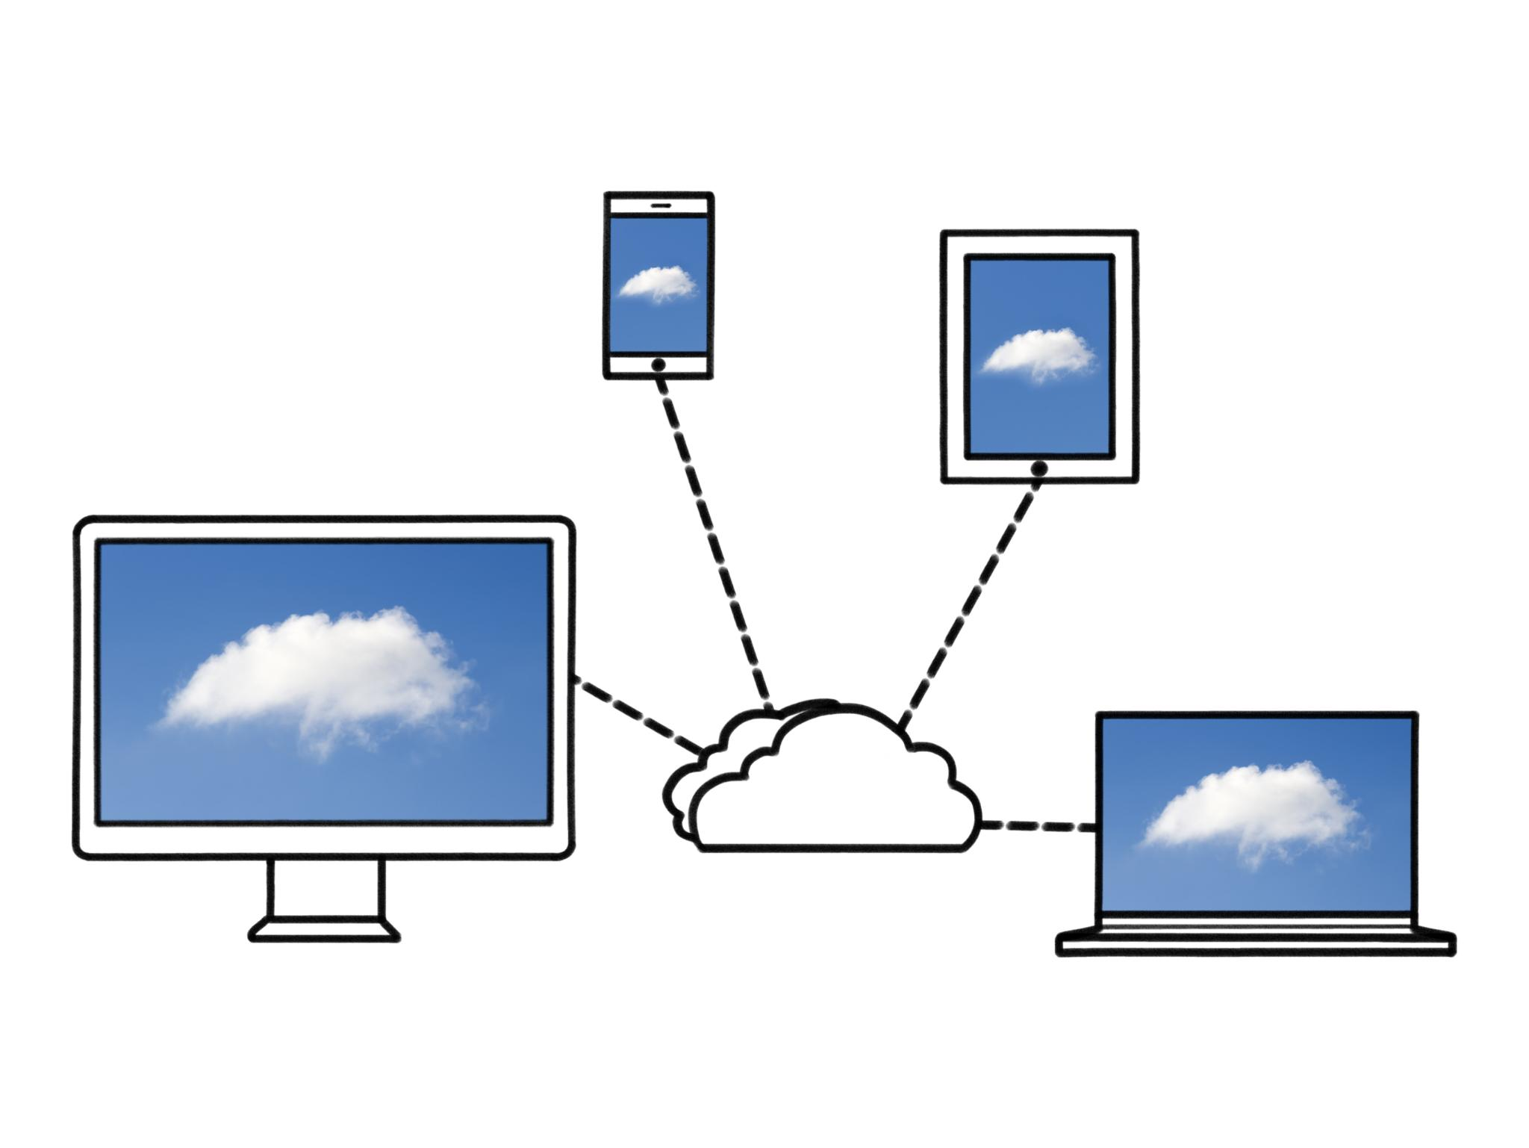
Agenda for Operating System Deployment
Ask Us Anything… (OSD)
Basics of Operating System Deployment (OSD)
Configuration Manager OSD Troubleshooting
Common Deployment Issues
OSD Debugging Tools
Notes:
This presentation will cover the basics of Operating System Deployment, including the deployment phases and an introduction to OSD. We will then discuss troubleshooting techniques specific to Configuration Manager, common deployment issues, and useful debugging tools.

Slide 5

ASK US ANYTHING OSD…..
Hey, we have a presentation, but we’d like to tailor our session to what you need… if we’re already covering it, great, if not… maybe we will…

Slide 6
Basics of Operating System Deployment (OSD)
Notes:
Understanding the fundamentals of Operating System Deployment is essential for troubleshooting. We will explore the key phases involved in OSD and the tools used throughout the process.

Slide 7
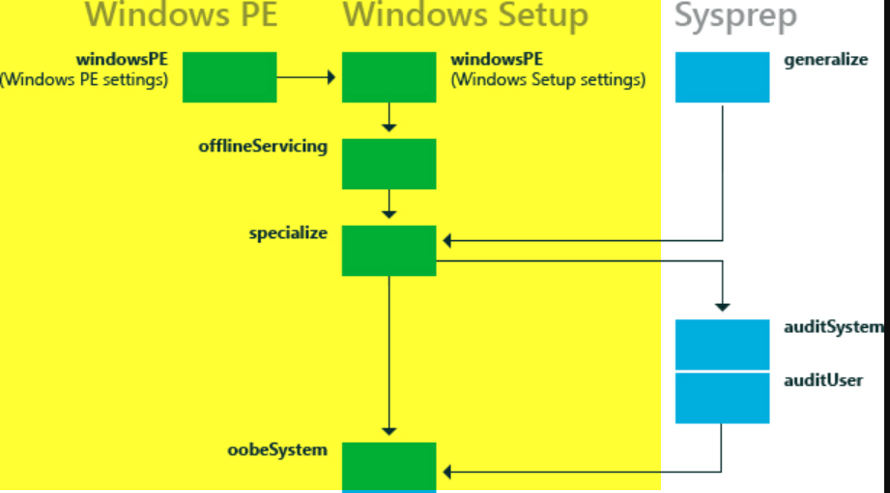
Introduction to OSD
Taking a machine, installing an OS, prepping it for use by end user.We’ll be just talking about Windows OSD
Several Phases of the Process
WinPE (Offline) -> Specialize -> OOBE (Setup Complete runs here)
Notes:
Operating System Deployment involves installing and configuring an operating system on multiple devices efficiently. It streamlines the deployment process, making it easier to manage large-scale installations.

Slide 8
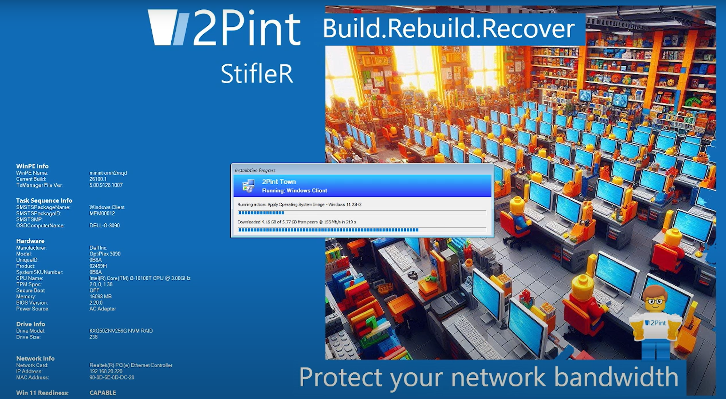
WinPE Phase
Initial Boot Environment
WinPE serves as the initial boot environment, critical for starting the deployment process effectively.
Things to note: Boot Media is important
Drivers
Patching (for Secure Boot)
Components (.Net, PowerShell, etc)
WiFi? WinRE
BGInfo is nifty
Custom Background for Branding
How do you get to WinPE?
PXE / iPXE
USB
Staged from Full OS
Notes:
The Windows Preinstallation Environment (WinPE) phase is the initial boot environment used to start the deployment process. This lightweight OS allows you to perform various installation tasks.

Slide 9
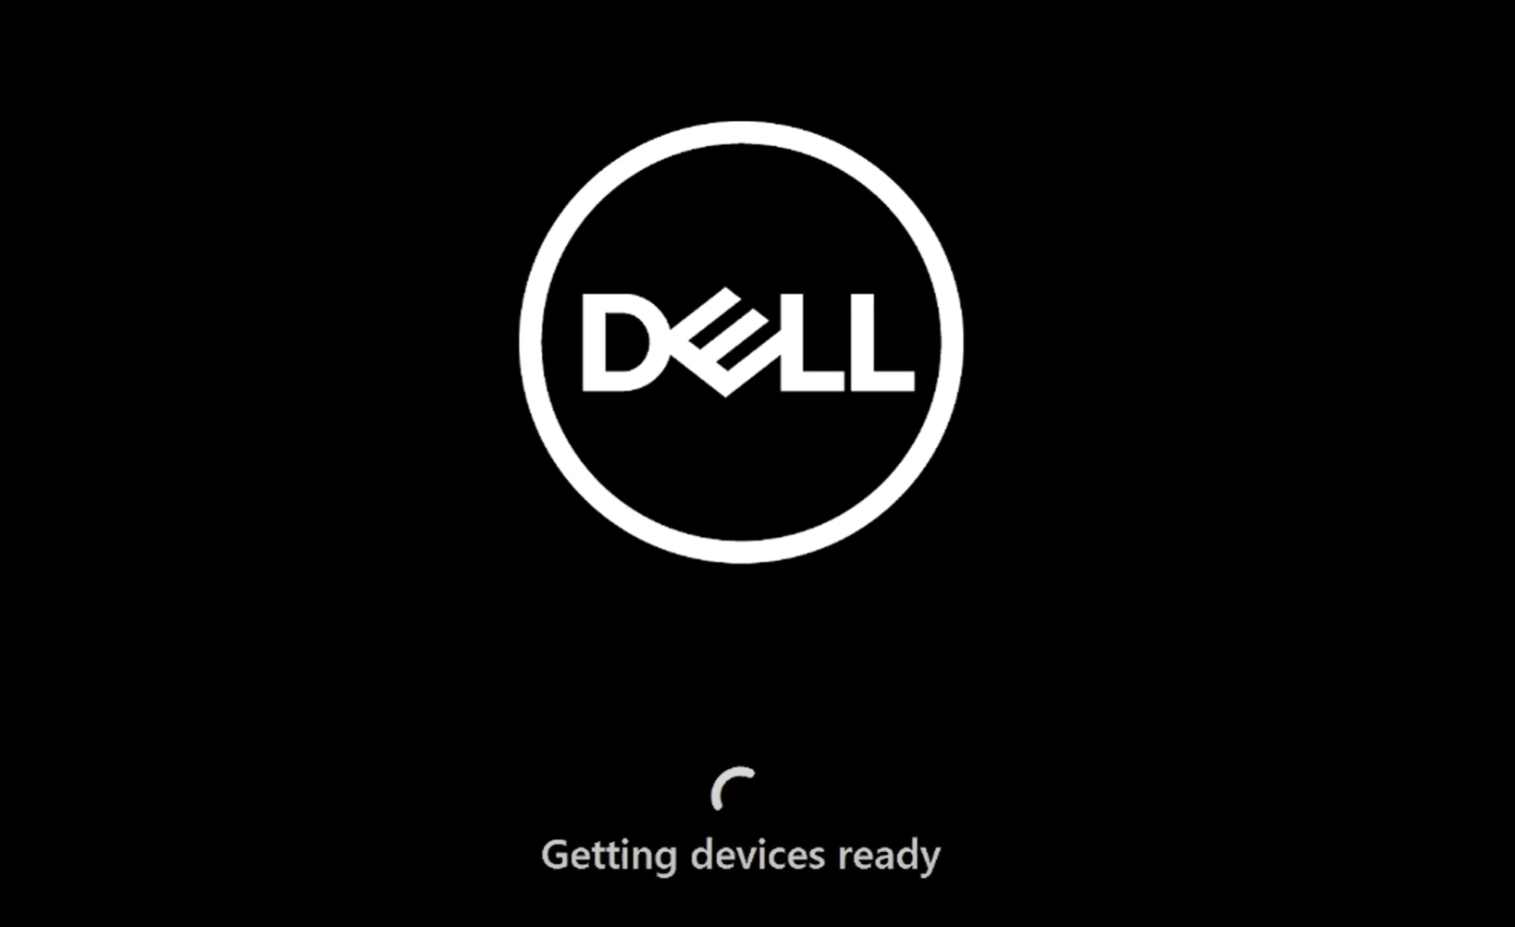
Specialize Phase
This Phase is the first phase in which you’re booted into the OS you’ve installed… it’s not fully functional yet, and it’s installing the drivers and doing additional things based on the unattend file.
This phase runs all by itself based on previously provided instructions, you do not see the ConfigMgr progress UI here…
Notes:
In the Specialize phase, hardware-specific settings are applied. This includes configuring network settings, joining domains, and setting up user accounts, ensuring the system is tailored to the specific hardware.

Slide 10
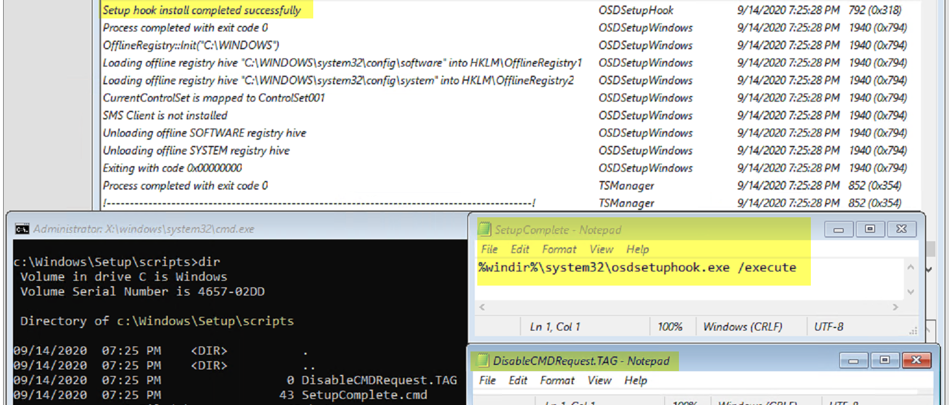
Setup Complete
ConfigMgr leverages the SetupComplete.cmd file to kick back off the Task Sequence Progress (osdsetuphook.exe), which it creates back in the WinPE phase. Rest of the TS is run during this phase.
Notes:
The Setup Complete phase finalizes the installation process. It runs last-minute configurations and prepares the system for first-time use by the end-users.

Slide 11
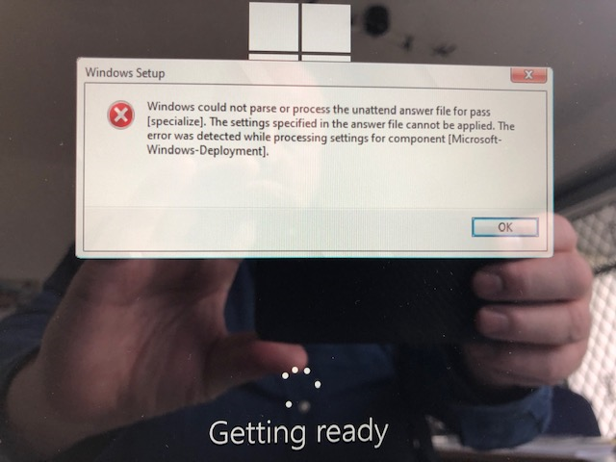
Unattend File… do I need one, should I provide one?
Yes you need one… but…
To apply a custom unattend file, or not to apply custom unattend file, that is the question….
My recommendation…. Do NOT
ConfigMgr builds the unattend file along the way with the required settings to continue on. Anything else, you can use the magic of the Task Sequence to accomplish.

Slide 12
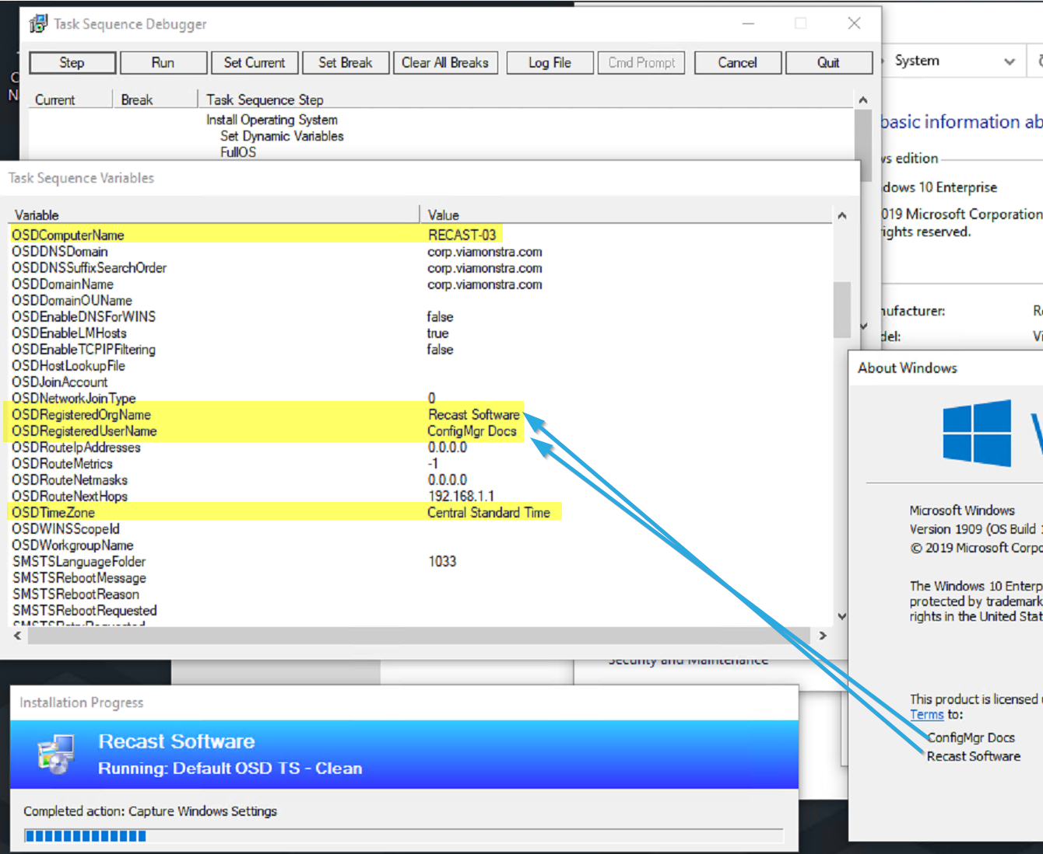
So how does CM build that unattend file?
It uses several steps and variables to auto generate one as the TS goes. DETAILS: Capture & Apply Settings Combined
Steps include:
Capture Network Settings
Capture Windows Settings
Apply Network Settings
Apply Windows Settings

Slide 13
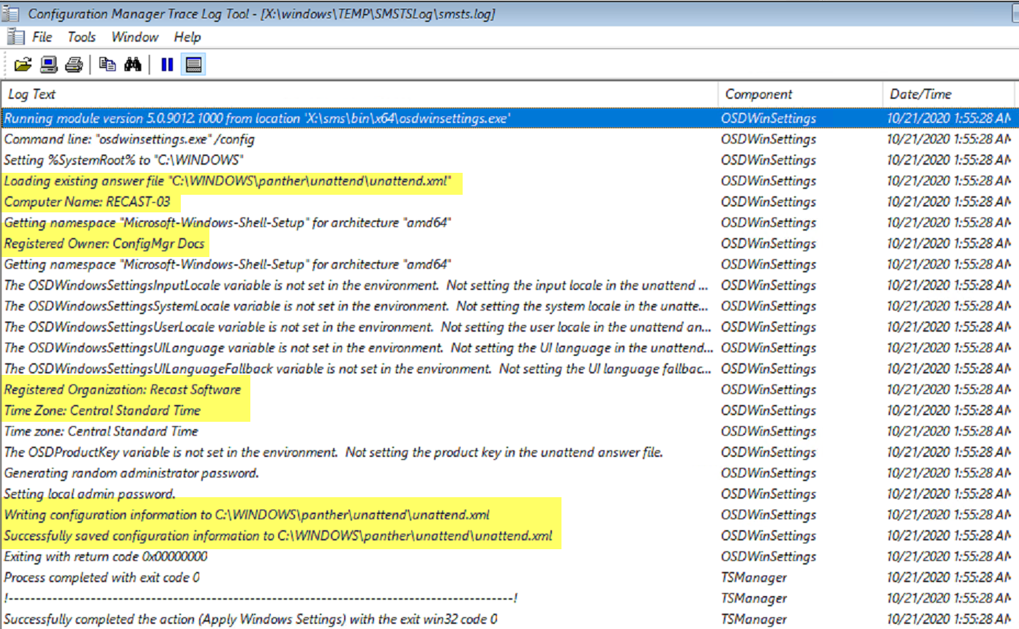
Building Unattend
As the steps run, you’ll see in the smsts.log the different items being added into the unattend.xml

Slide 14
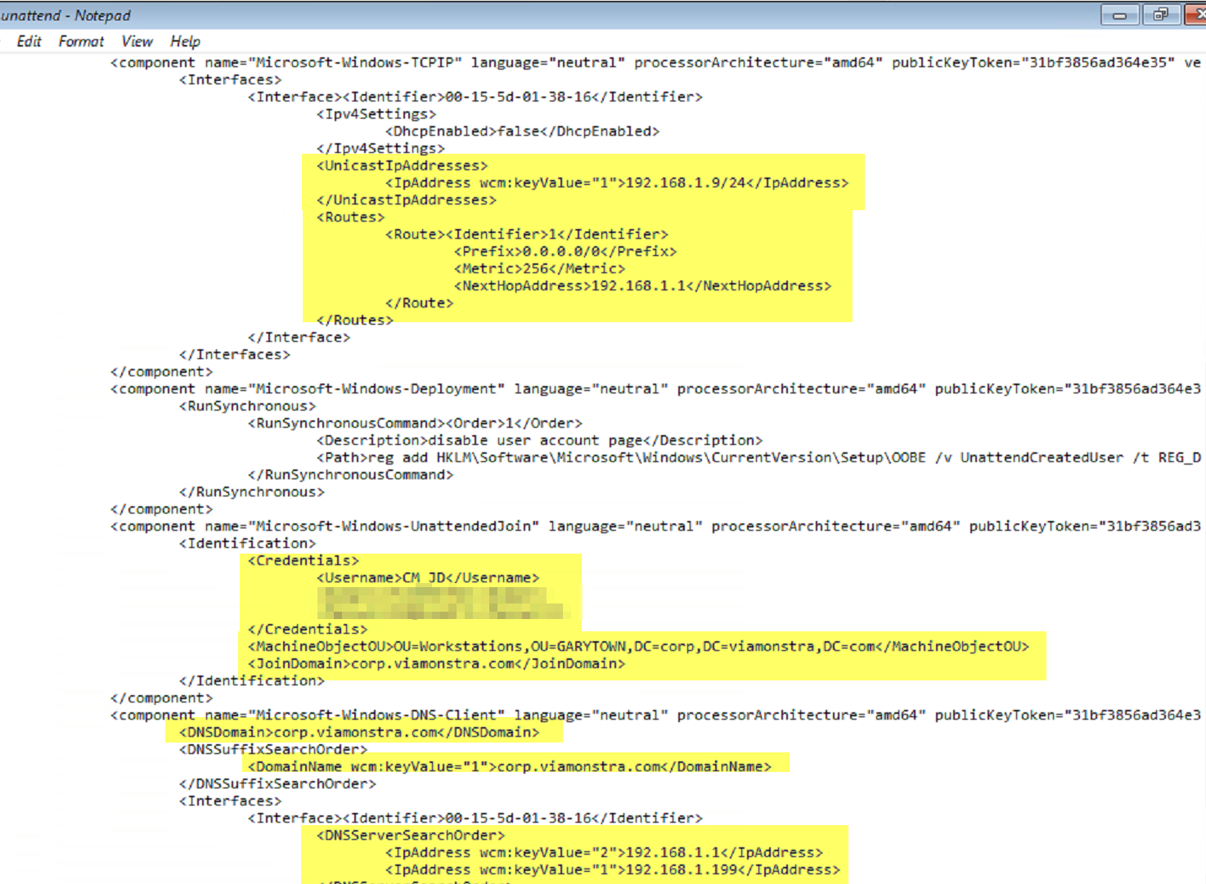
Unattend
All the info from those earlier steps is now living in the unattand file which is passed into specialize to get applied.

Slide 15
Configuration Manager OSD Troubleshooting
Notes:
Configuration Manager is a powerful tool for managing operating system deployments. Understanding its functionalities is essential for diagnosing and resolving OSD issues.

Slide 16
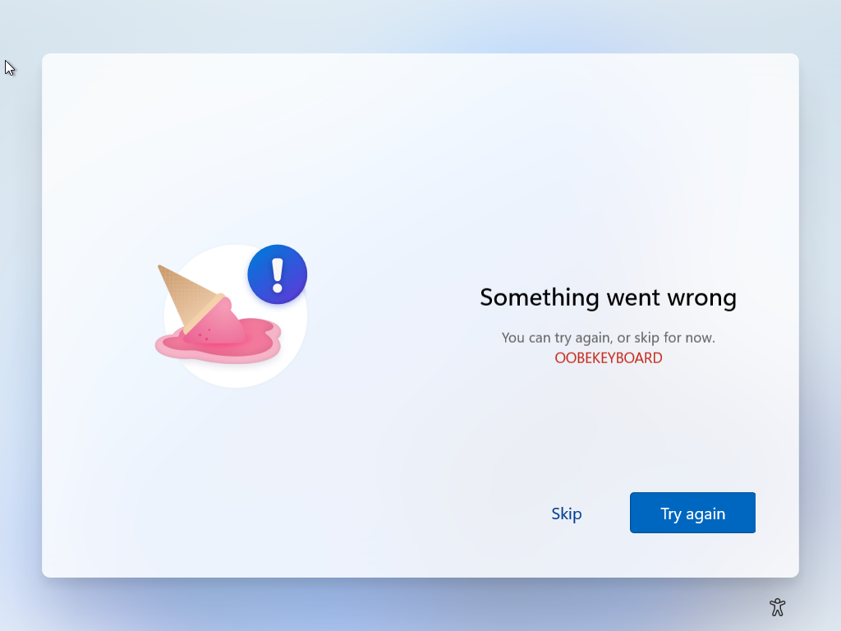
Common Task Sequence Issues
Misconfigurations
Content / Boundaries / Order of operations (Sometimes installing Security Apps break other installs) / Deployment options (collection / Agent vs Media / PXE.
Incorrect Sequences
Missing required steps, using steps wrong (Apply Windows Settings vs Join Domain), Command Line or PowerShell script issues.
Wrong / Missing Drivers
Storage and Network seem to cause biggest issues
Build and Capture Image issues
Was it built on a VM or physical hardware?
Notes:
Task sequences can often encounter issues during deployment. Common problems include misconfigurations, incorrect sequences, and missing drivers. Identifying these issues quickly is key to maintaining deployment efficiency.

Slide 17
Common Deployment Issues
Notes:
Despite careful planning, deployment issues can still arise. Identifying and resolving these common problems is essential for ensuring a smooth OSD process.

Slide 18

Domain Join Problems
Network Connectivity Issues
Network connectivity problems can hinder the domain join process, causing deployment failures and delays.
Incorrect Credentials
Using incorrect credentials during the domain join can result in access failures and necessitate troubleshooting.
Domain Policy Settings
Domain policy settings must be configured correctly to enable successful domain joining during OSD.
Notes:
Domain join issues are frequently encountered during OSD. These can arise from network connectivity problems, incorrect credentials, or domain policy settings that must be addressed for successful deployment.

Slide 19
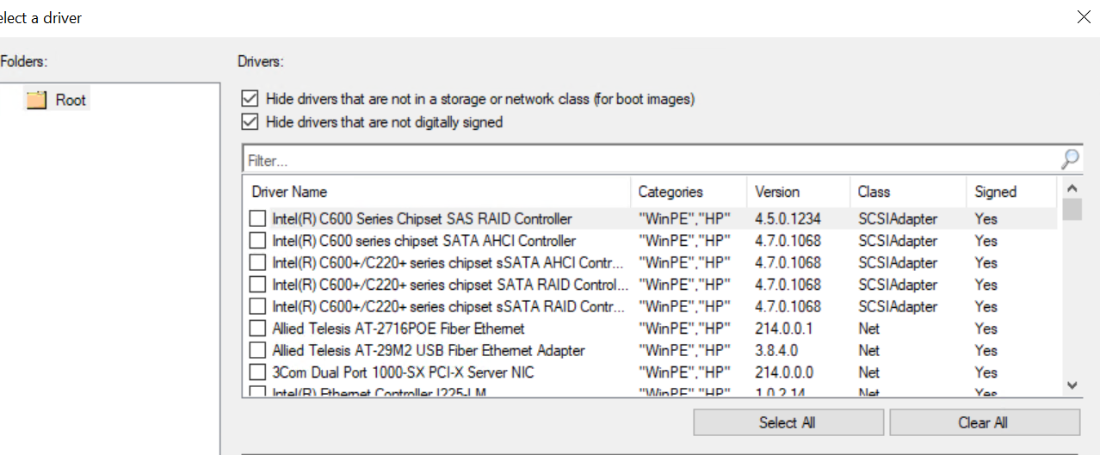
Driver-Related Issues
Looking at you Dell…. Enabling RAID in the bios by default? Why?
AHCI for the win! But if it’s too late, make sure you’ve added the correct RST drivers from intel into your boot image. This can be a little trial and error. Then make sure you’re getting those same drivers applied to the machine!
Touchpad / Touchscreen drivers. If you want those during OSD. When add drivers into boot image, make sure you don’t limit to “Storage / Network Class” or you’ll miss some of these.
Notes:
Driver-related problems can prevent successful deployment. Ensuring the correct drivers for targeted hardware are included in the deployment package is essential to avoid these issues.

Slide 20
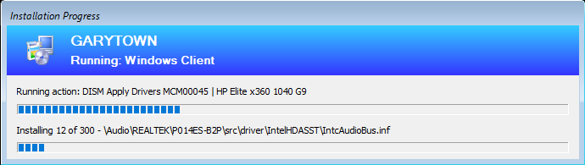
Driver-Related Issues - Continued
Don’t import drivers into CM… just don’t do it! I typically will only import the WinPE driver packs, and even that I rarely do anymore..
Move to “Modern CM Driver Management”, create standard packages of the driver content, with a custom step to apply the drivers to the offline image. It allows for faster deployments (if you WIM the contents), it’s instant for creating the package vs waiting for ever for the import wizard,
DISM Apply Drivers – TSProgressUI SubBar – GARYTOWN ConfigMgr Blog
Driver packs, you need to stay on top of this. Update regularly, or create your own updated ones with vendor tools. Make sure you’re testing, so much hinges on drivers now.
Offline & Online stages
UWP App Drivers (HSAs). Many driver packs include these, which do not get installed automatically, You’d have to run separate script in Full OS to apply. New Combined Driver and UWP-HSA Packs | hp's Developer Portal
Notes:
Driver-related problems can prevent successful deployment. Ensuring the correct drivers for targeted hardware are included in the deployment package is essential to avoid these issues.

Slide 21
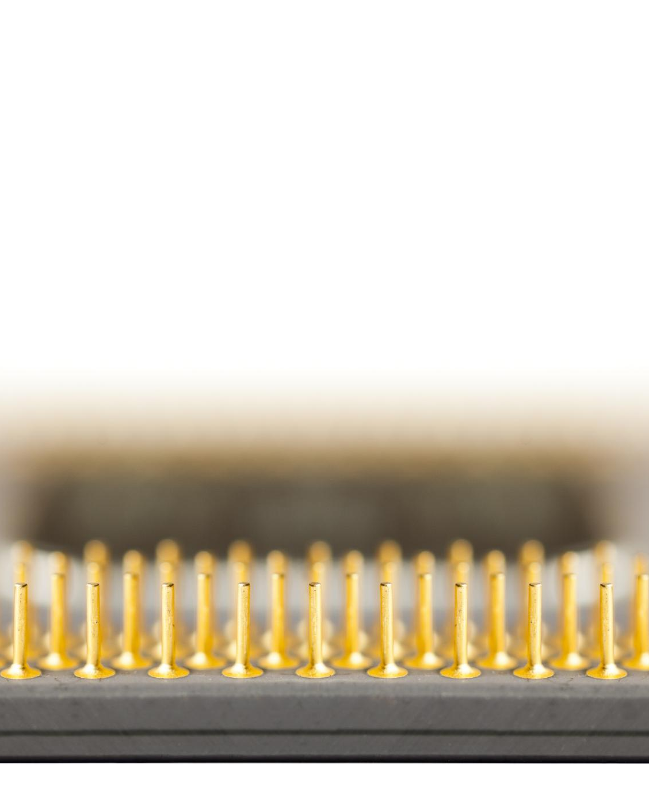
Impact of Hardware
Compatibility Issues
Windows 11 is the big question right now, but anything for the past 8 years *should* support Windows 11. NOTE that some models sport Windows 11 in general, but perhaps not the latest releases, so you’ll want to also pay attention to that.
Specific Hardware Settings
I highly recommend going through your BIOS settings and double checking what they are and how they are set from the OEM, then only using drivers from the OEM.
If you contact OEM support, they will first have you run their OEM tools to update drivers, and many times, that resolves the issue.
When possible and where it makes sense, STANDARDIZE
Notes:
The hardware used can greatly affect OSD outcomes. Compatibility issues, performance limitations, and specific hardware settings should be reviewed to ensure successful deployment.

Slide 22
OSD Debugging Tools
Notes:
Debugging tools are invaluable when troubleshooting OSD. They help identify and resolve issues effectively, ensuring smooth deployment operations.

Slide 23
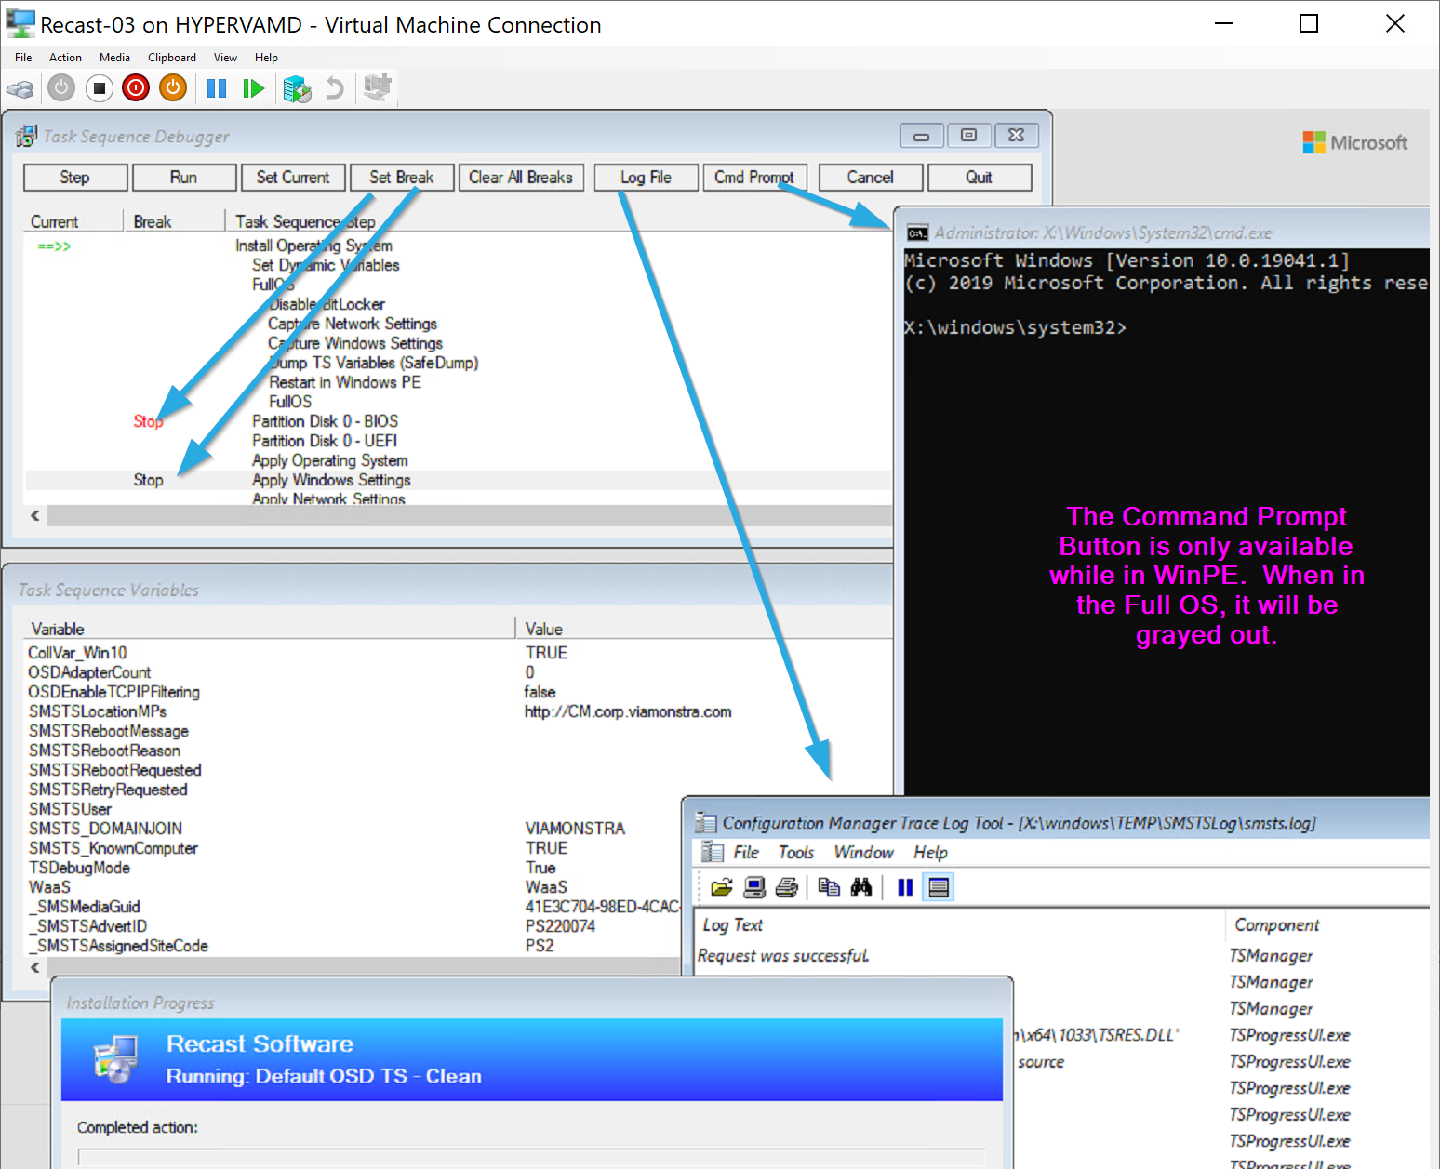
Introduction to the CM OS Debugger
Enable it several ways, I prefer to set a variable before the step I want to start debugging.
Provides list of variables, and allows you to step through TS
Requires Admin rights when starting in Full OS
Notes:
OSD Debugging Tools facilitate the identification of issues during the deployment process. They provide insights into the deployment environment and help diagnose problems effectively.

Slide 24

Debug / Testing Scripts in WinPE and Full OS
Create a Debug TS that you can launch from the Full OS or from WinPE. In the Full OS, set it to launch ISE so you can test your scripts while it interacts with the TS environment. In WinPE, have it launch PowerShell, and you can then trigger scripts or sections of code.
I like to host my scripts on GitHub, then I can trigger them in WinPE via simple command like: iex (irm “url to script”) As it errors, I can fix the script on GitHub and try again, or pull a section of the code and walk through it local.
Notes:
Testing scripts during the WinPE phase and in the fully deployed OS is crucial for identifying potential errors. This proactive approach ensures a more reliable OSD process.

Slide 25
Conclusion
Understanding Deployment Phases
A clear understanding of the deployment phases is crucial for effective troubleshooting and successful deployment outcomes.
Identifying Common Issues
Being aware of common issues that arise during deployment allows IT professionals to address them promptly and efficiently.
Utilizing the Right Tools
Using the appropriate tools and techniques can significantly enhance the troubleshooting process and improve deployment efficiency.
Notes:
In conclusion, effective troubleshooting of Operating System Deployment involves understanding its phases, common issues, and utilizing the right tools. By applying the techniques discussed, IT professionals can significantly enhance their deployment processes.

